Slide 1
Effect of Prescribed Burning on Forest Microbial Community

Slide 2
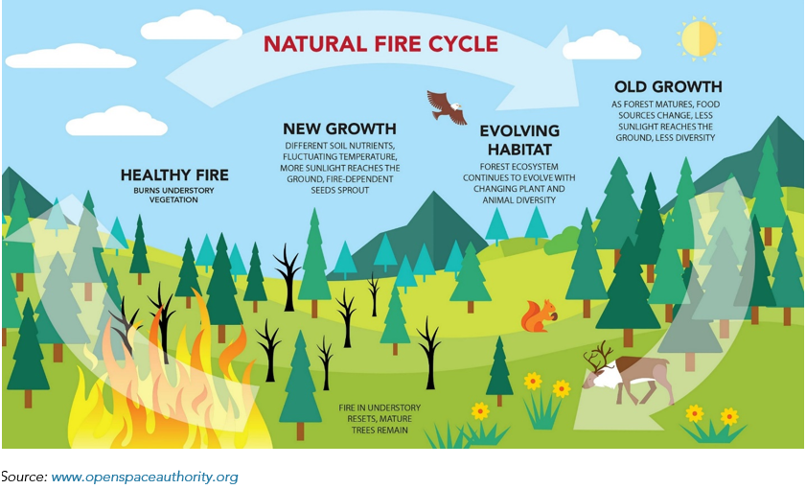
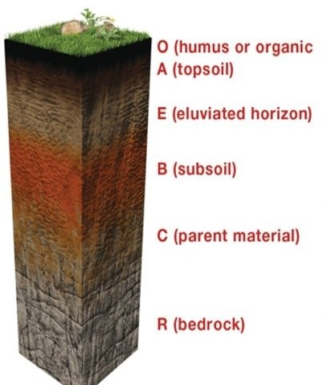
Background – Forest fires, prescribed burns, and soils
Notes:
Forest fire Image from here:
https://ww2.arb.ca.gov/resources/documents/frequently-asked-questions-wildfire-emissions
Soil image from here:
https://tunza.eco-generation.org/worldReportView.jsp?viewID=52477

Slide 3
Scientific question and hypothesis
How do forest fires impact soil microbial communities in different soil horizons?
Hypothesis:
Prescribed burns would cause significant community shifts
Changes in nutrients
pH
Extremophiles appear

Slide 4
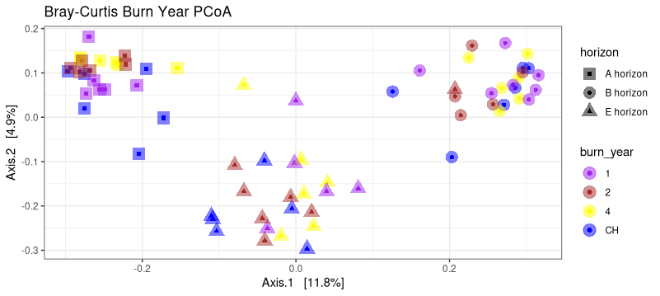
Variance in data is attributed soil horizon of samples as opposed to the burn timeframe

Slide 5
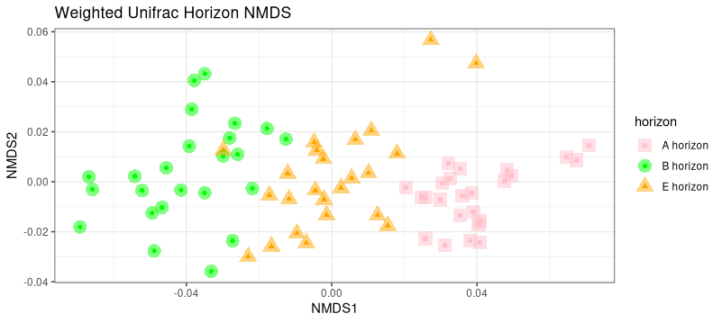
NMDS analysis results in low-stress model using soil horizon

Slide 6
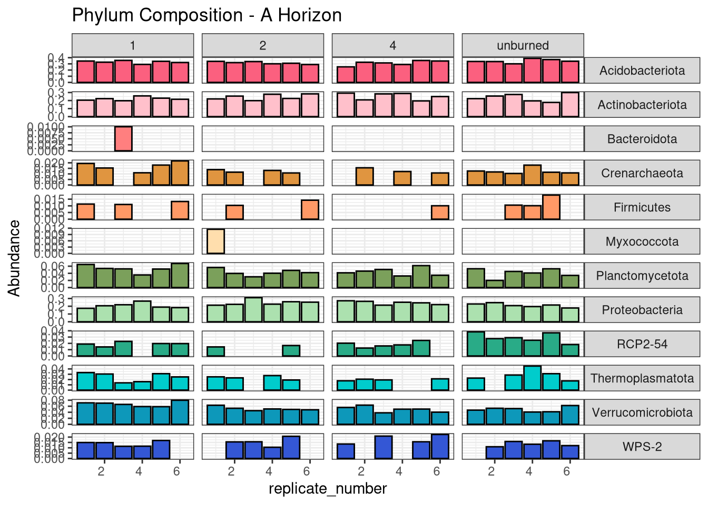
Relative abundance at the Phylum level remains consistent across all burn time frames in each soil horizon

Slide 7
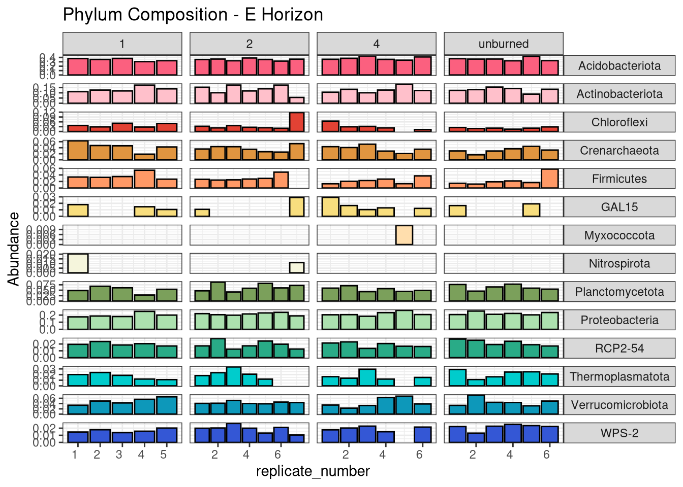
Relative abundance at the Phylum level remains consistent across all burn time frames in each soil horizon

Slide 8
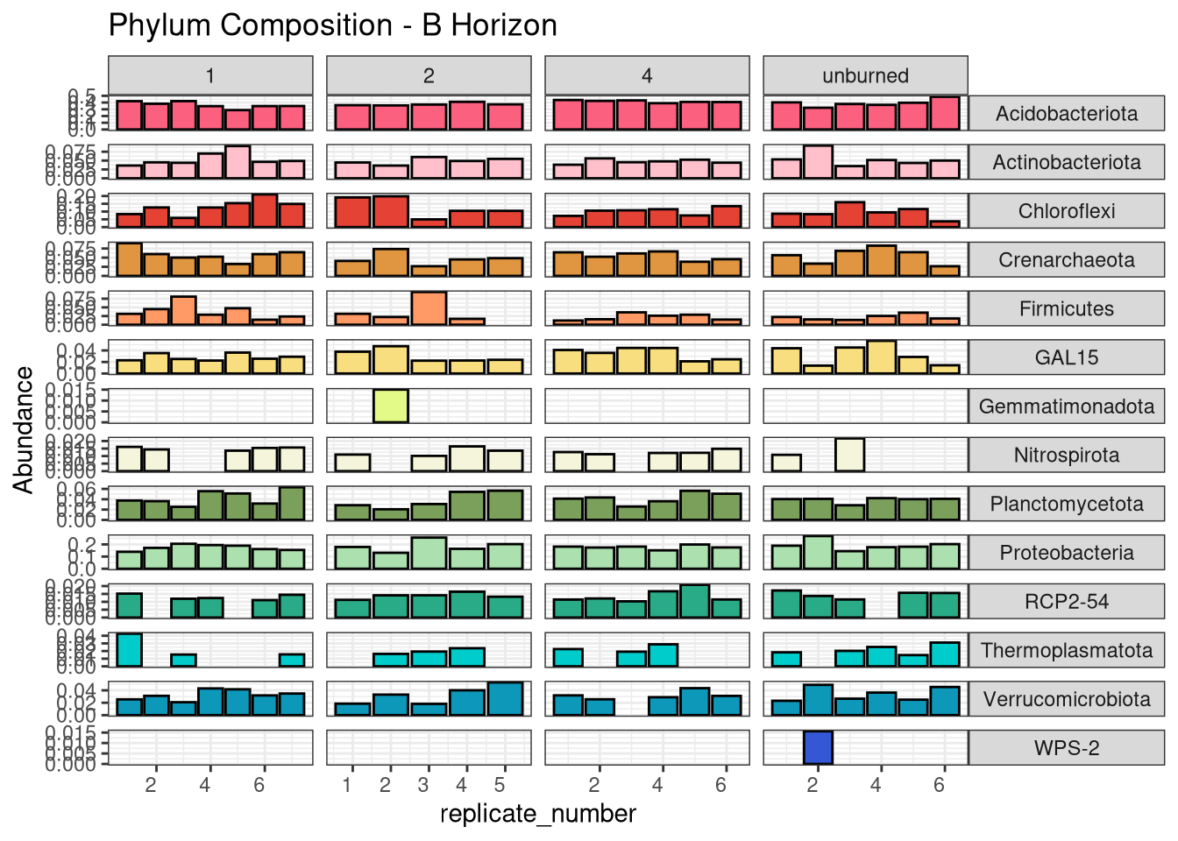
Relative abundance at the Phylum level remains consistent across all burn time frames in each soil horizon

Slide 9
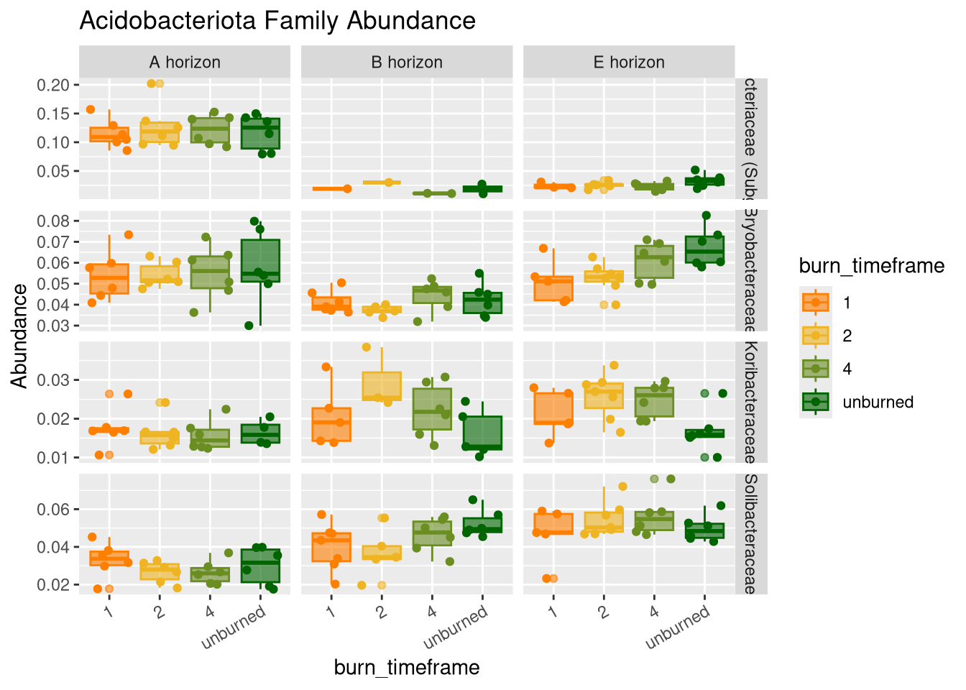

Slide 10
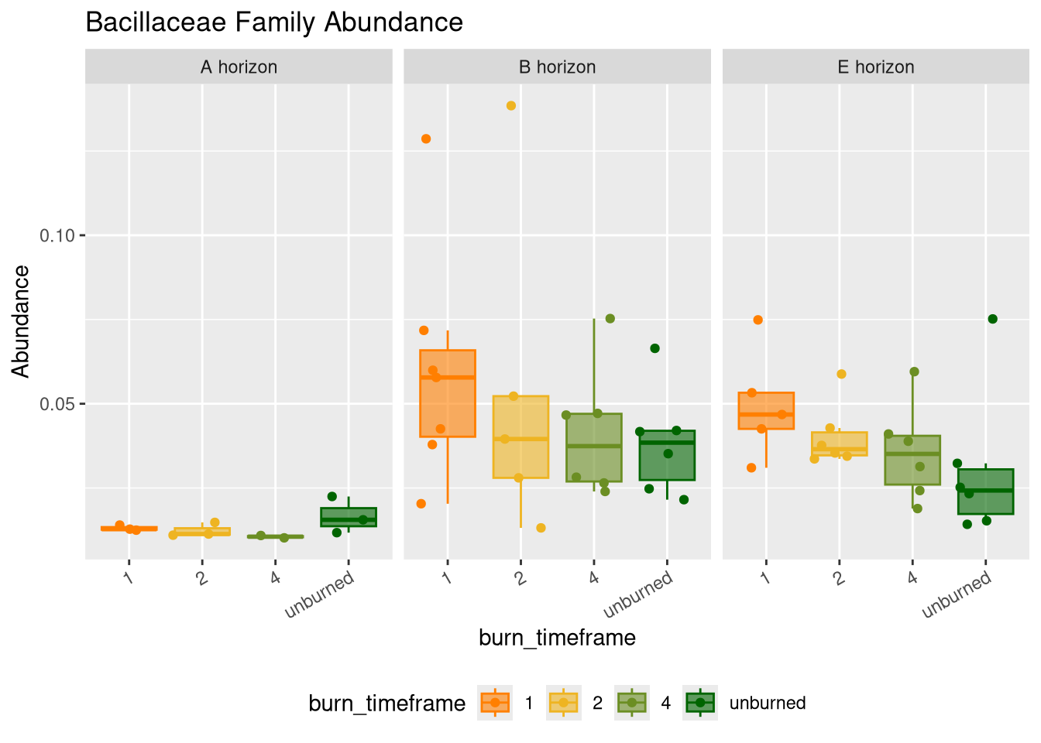
Bacillaceae family abundance varies significantly across soil horizons, and slightly across burn timeframes in a soil horizon

Slide 11
Conclusions
Samples cluster strongly and significantly based on their soil horizon, and less so based on their burn timeframe
Within a soil horizon group, there is no significant separation or clustering based on the burn timeframe

Slide 12
Data citation
Fox, Sam and Taylor, Melanie K. and Jumpponen, Ari, Fire-Excluded and Frequently Burned Longleaf Pine Forests Have Contrasting Soil Microbial Communities. Available at SSRN: https://ssrn.com/abstract=4415149 or http://dx.doi.org/10.2139/ssrn.4415149

Slide 13
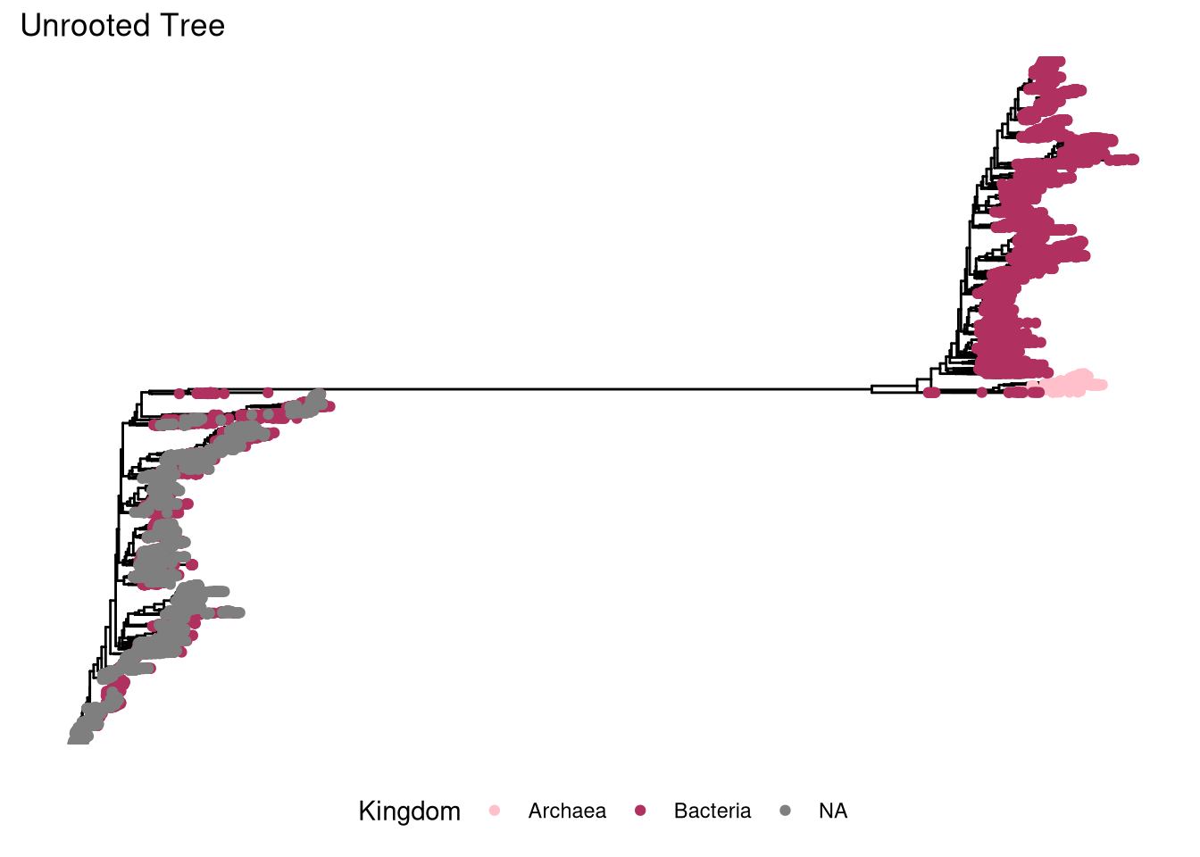

Unrooted tree of ASVs shows a high number of unclassified taxa at the Kingdom level, and a large split in the tree

Slide 14
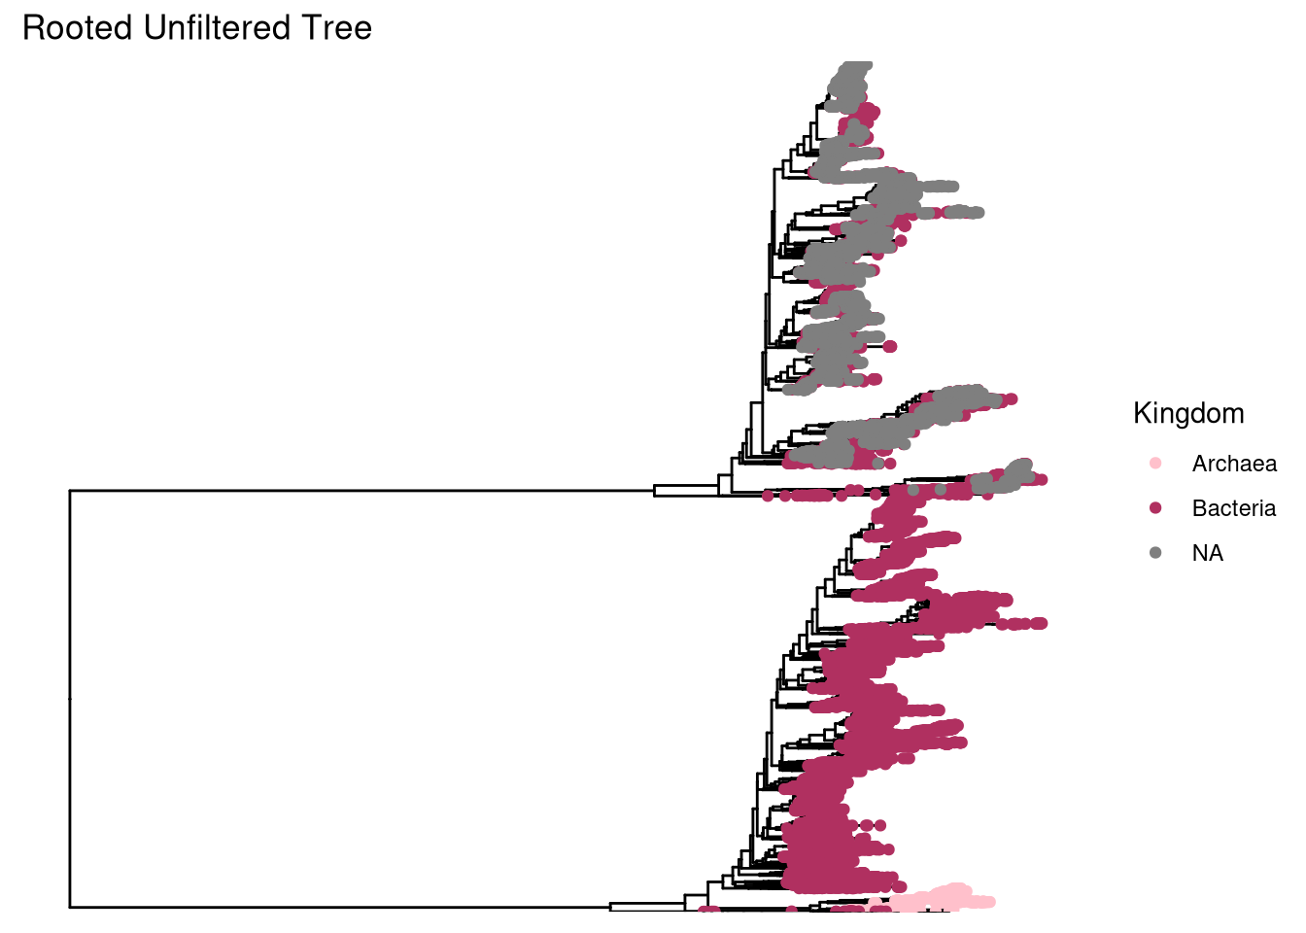
Rooting the tree still results in a major split into two very distinct groups: Bacterial- and Archaeal-classified ASVs, and a mix of Bacterial and unclassified ASVs

Slide 15
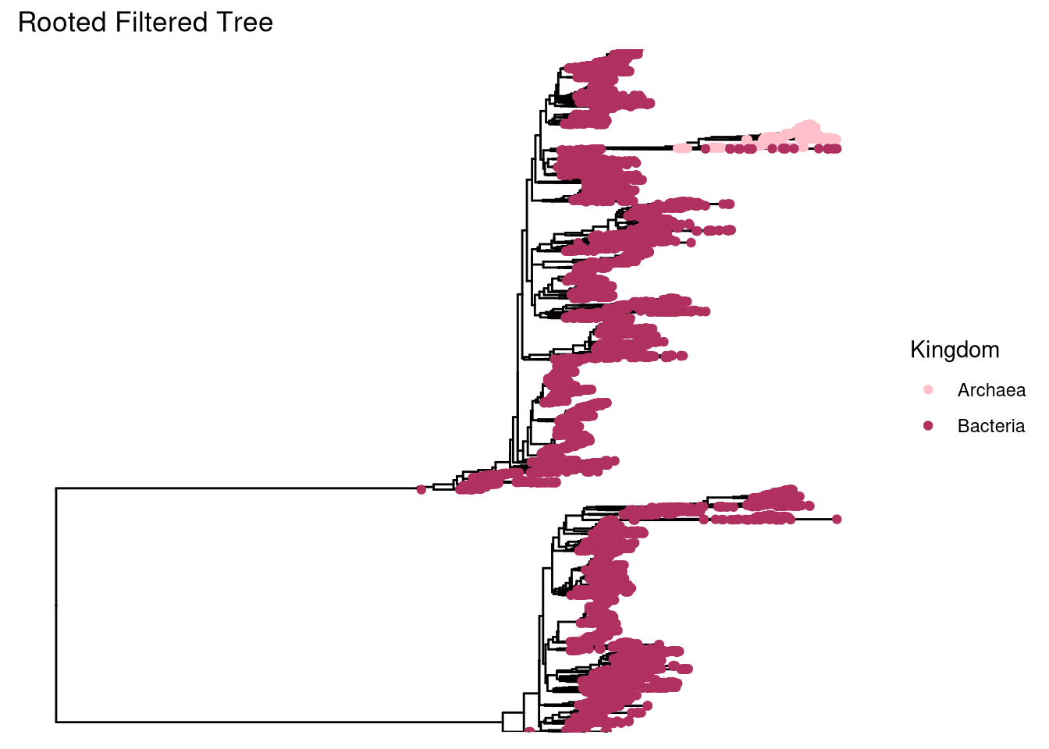

The phylogenetic tree maintains a very dramatic split into two major groups, even after filtering out the ASVs that are unclassified at the kingdom level and rerooting the tree

